Slide 1
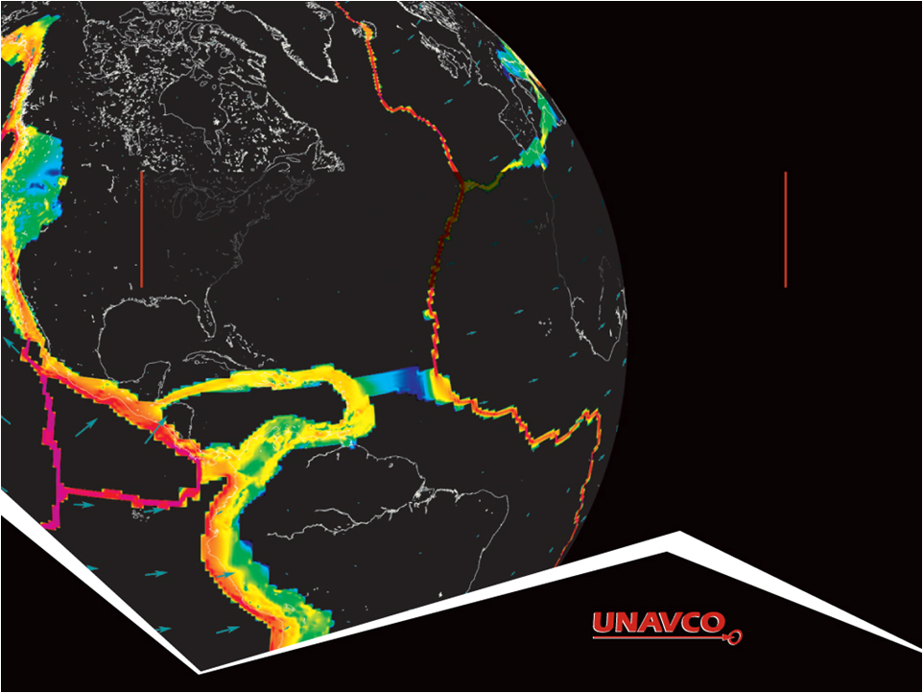
Introduction to Global Navigation Satellite Systems (GNSS Acknowledgements: Vince Cronin (Baylor University), Shelley Olds (UNAVCO), Beth Pratt-Sitaula (UNAVCO), Benjamin Crosby (Idaho State), Ian Lauer (Idaho State)
Version May 2019
Notes:
This slideshow goes over the basics of how the global positioning system (GPS) works. GPS is the USA-based component of the GNSS (global navigation satellite system), which includes many more satellites than just the ones in orbit by the USA.
Questions or comments please contact Vince_Cronin AT baylor.edu or education AT unavco.org

Slide 2
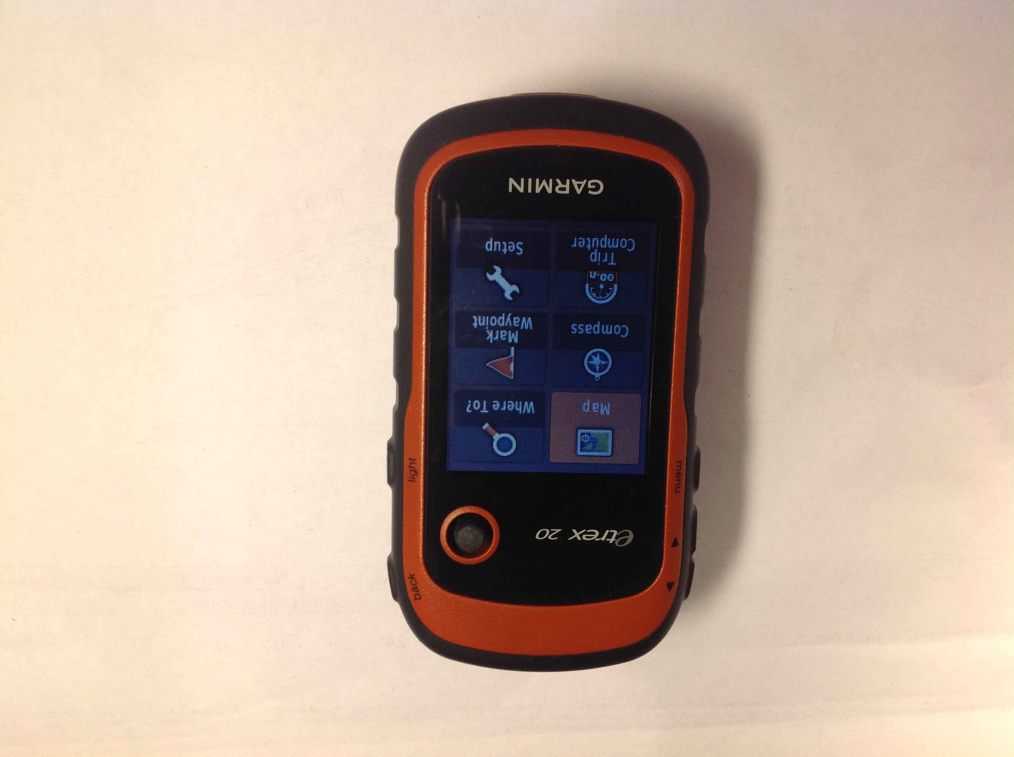
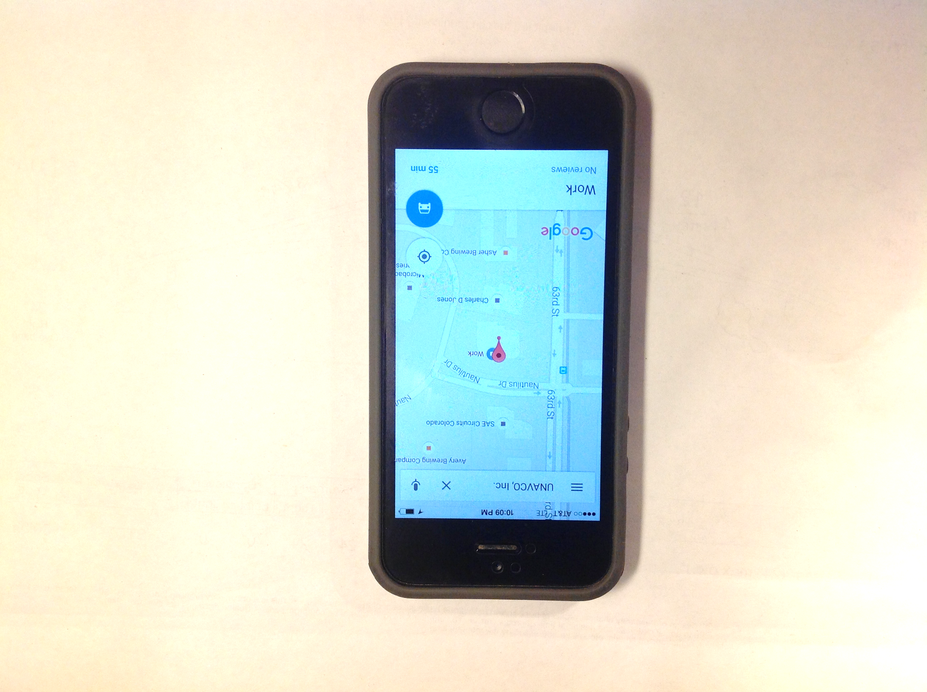
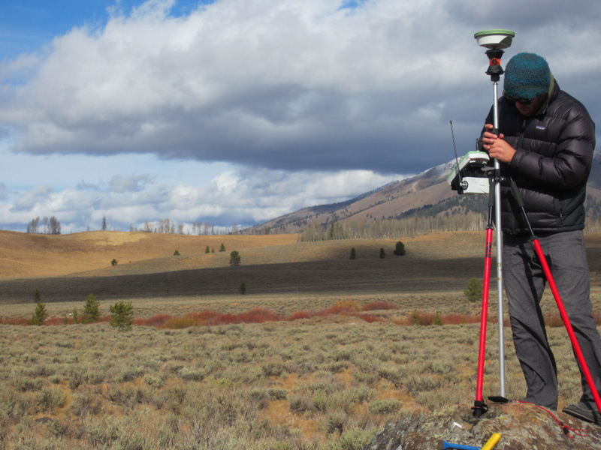
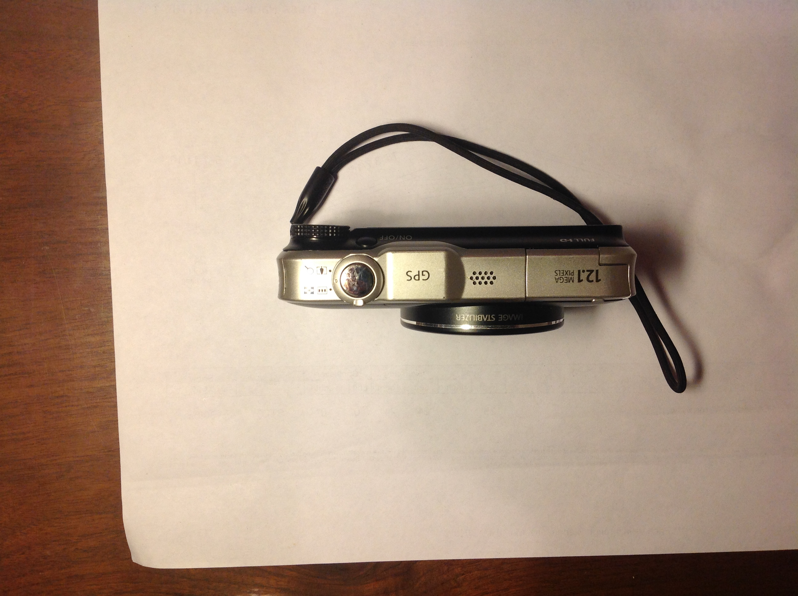

GPS receivers are all around us
Notes:
Whether they know it or not, students use GPS receivers daily in their cars, phones, cameras, and handheld recreational GPS. Most have heard the term “GPS” but few know much about how the system actually works or high precision GPS/GNSS for science and industrial use.
Left images: UNAVCO
Right field images: B. Brosby

Slide 3
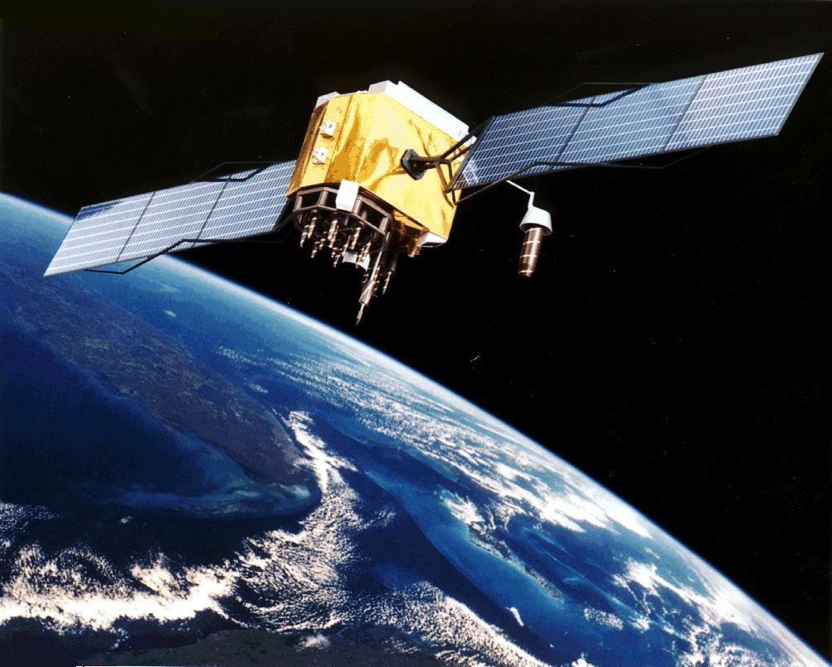
Multiple satellite systems
There are multiple Global Navigation Satellite Systems (GNSS)
GPS: USA, global
GLONASS: Russia, global
BieDou: China, global
Galileo: Europe, global
IRNSS (India), regional
QZSS (Japan), regional
Artist’s conception of a GPS Block II-F satellite in Earth orbit. (Public domain from NASA) https://en.wikipedia.org/wiki/Global_Positioning_System
Notes:
Most modern systems take advantage of the first two systems listed here…even smartphones. The more satellites, the more likely you will get a position even in areas with limited sky such as in a city with tall buildings.

Slide 4
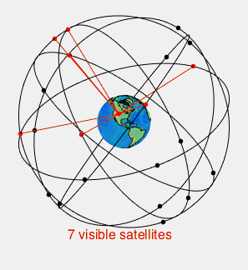
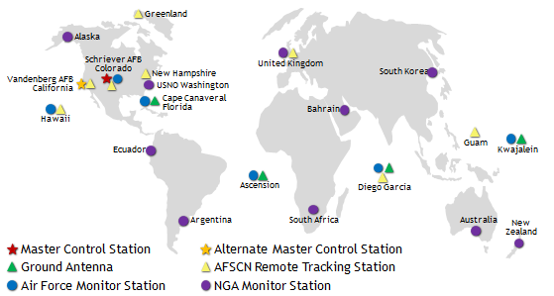
Global Positioning System
GPS: the US System
31 satellites
20,200 km altitude
55 degrees inclination
12 hour orbital period
Ground control stations
Each satellite passes over a ground monitoring station every 12 hours
Most recent satellite available May 25, 2022
https://commons.wikimedia.org/wiki/File:GPS24goldenSML.gif
Notes:
From the users point of view, GPS is a passive system: you need only a low-powered receiver to obtain the signals, which contain all the information you need to determine your position. This requires that the satellites carry atomic clocks to keep accurate time and transmit to the user the position of the satellite in the sky. The orbits are computed by Department of Defense (DoD) by tracking the satellites from ground control stations. GPS control segment consists of a global network of ground facilities that track the GPS satellites, monitor their transmissions, perform analyses, and send commands and data to the constellation. The current (as of 2015) operational control segment includes a master control station, an alternate master control station, 12 command and control antennas, and 16 monitoring sites. The ground control stations have known positions and are then uploaded to the satellites, which then transmit the information continuously along with the time. With hand-held receivers, it is possible to find your position to a few meters, limited primarily by the accuracy of the broadcast orbits. As we shall see, the civilian scientific community uses more than 200 stations to determine the orbits with an accuracy of a few centimeters, allowing millimeter positioning with after several hours of tracking.
Upper image: https://en.wikipedia.org/wiki/Global_Positioning_System
https://commons.wikimedia.org/wiki/File:GPS24goldenSML.gif
Lower image: http://www.gps.gov/systems/gps/control/ (public domain)

Slide 5
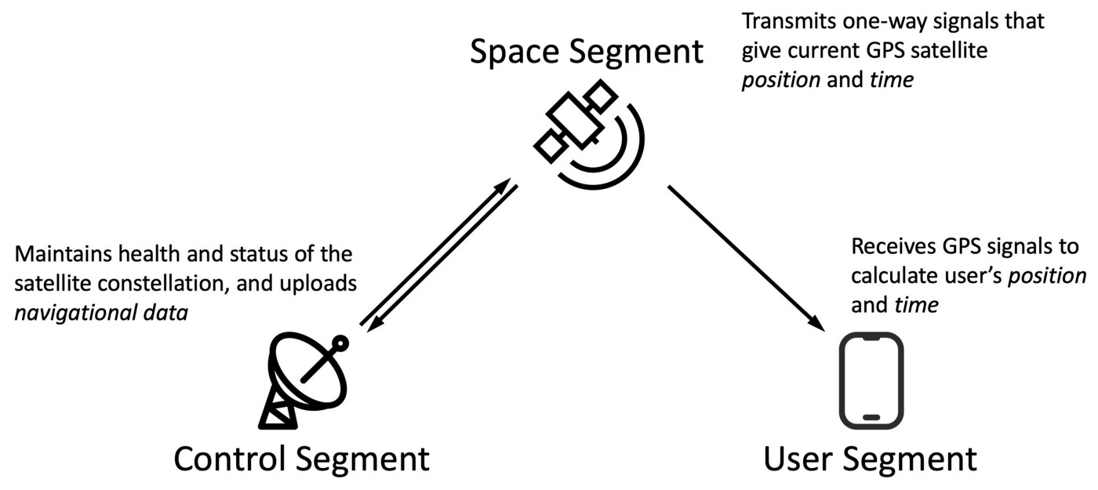
Components of a GNSS system
https://medium.com/@penrosewang/introduction-to-gnss-some-basics-2dc8cb716589

Slide 6
Components of a GNSS system
Satellites
Antenna + Receiver
Ground control
https://medium.com/@penrosewang/introduction-to-gnss-some-basics-2dc8cb716589

Slide 7
Satellite sends orbit and clock Info
GNSS satellites include almanac and ephemeris data in the signals they transmit
Almanac data are coarse orbital parameters for all GPS satellites. Communicated to your GPS so you can track satellites.
Ephemeris data are very precise orbital and clock correction for each particular GPS satellite—necessary for precise positioning
http://gpsinformation.net/main/almanac.txt
Notes:
A receiver that has recently (last several months) downloaded almanac data will know which satellites to expect in the sky for a given region and time. It helps a receiver “lock” into the satellite constellation more quickly. Think of the almanac as a catalog with general locations for all the GPS satellites.
Ephemeris data is critical to precise positioning. When ephemeris data is encrypted (selective availability), real-time GPS positions become significantly less accurate. In all cases ephemeris data can be obtained several weeks later so that non-real-time applications can achieve full accuracy. Each satellite only broadcasts its own ephemeris data.

Slide 8
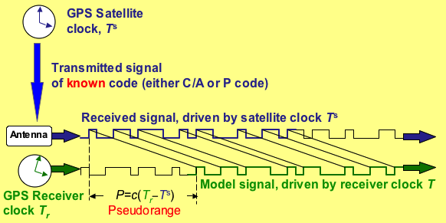
Measuring the range to the satellite
Radio signal from satellite tells GNSS receiver the satellite-clock time and provides the most recent corrections to the satellite’s position relative to Earth (ephemeris)
GNSS receiver compares multiple satellite-times to the receiver-time to determine the distance to each satellite
Notes:
Image: Vince Cronin (Baylor University)

Slide 9
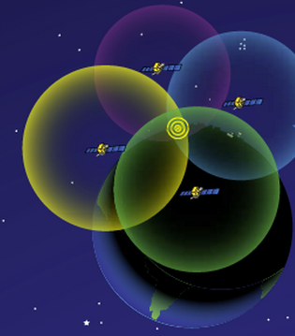
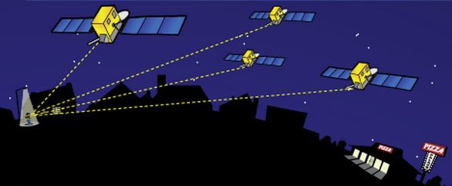
How actual location is determined
http://spaceplace.nasa.gov/gps-pizza/en/
Notes:
The time element is needed because of the difference between the highly accurate atomic clock on the satellites ($100,000 each) and the much-cheaper clock in the GPS receivers.
Although 4 is a technical minimum number of satellites, for geoscience research work it is highly recommended to have at least 6 satellites.
Although people will often refer to this process and “triangulation” in fact it is “trilateration” because it depends on distances rather than angles.
For a nice explanation of trilateration versus triangulation visit https://gisgeography.com/trilateration-triangulation-gps/.
Images from NASA (public domain) http://spaceplace.nasa.gov/gps-pizza/en/

Slide 10
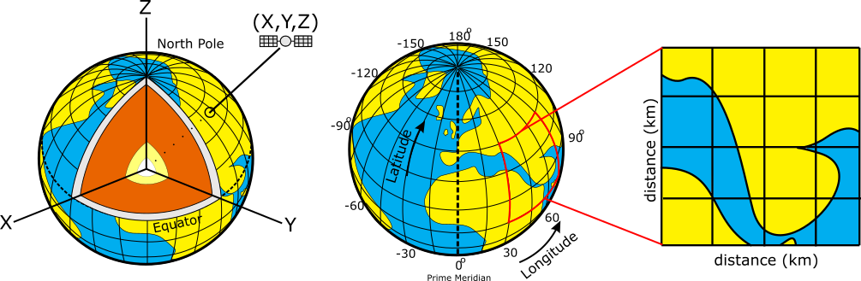
Components of a GNSS system
Positions on the earth can be reported using:
Cartesian coordinates (relative to the earth’s center)
Geographic coordinates (lat., long., elev., in deg.)
Projected coordinates (UTM, state plane, in m or ft)
Cartesian (X,Y,Z)
Geographic System
Projected System
(Figures: Ian Lauer, modified from Common Domain)
Notes:
It is important for students to understand that position data can be reported to a user in a number of different formats.

Slide 11
GNSS provides 3D positioning
Positions on the earth can be reported using:
Cartesian coordinates are used in satellite navigation, including GNSS (“Earth-centered, Earth-fixed” system)
Cartesian (X,Y,Z)
(Figures: Ian Lauer, modified from Common Domain)
Notes:
It is important for students to understand that position data can be reported to a user in a number of different formats.

Slide 12
GNSS provides 3D positioning
Positions on the earth can be reported using:
Cartesian coordinates are used in satellite navigation, including GNSS (“Earth-centered, Earth-fixed” system)
GNSS signal communicates the position and velocity of the satellite at a particular time
Q. - How many satellites are needed to determine one’s position in 3D space using GNSS?
Cartesian (X,Y,Z)
(Figures: Ian Lauer, modified from Common Domain)
Notes:
It is important for students to understand that position data can be reported to a user in a number of different formats.

Slide 13
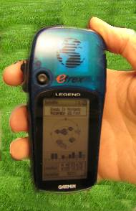
Antennas receive data streams
Works the same…
Notes:
Since each satellite maintains time very accurately (~1 nanosecond = 30 cm), it can tag its signal with the time of transmission. This information, together with the location of the satellite, also transmitted to the receiver, is sufficient to allow the receiver to calculate the range to each satellite, provided that the receiver also knows the time. Equipping receivers with atomic clocks would be very expensive, so the receiver tags the signal with the time of its internal clock to create a “pseudorange” (range plus an unknown clock correction). The software in the receiver then uses the pseudoranges from four satellites to solve for the four unknowns: three coordinates and the receiver clock correction.
Images: Vince Cronin (Baylor University)
High precision rates taken from GAMIT/GLOBK 10.6 release notes - http://geoweb.mit.edu/gg/
After 24 hours
Horz: +/- 1-2 mm
Vert: +/- 5 mm

Slide 14
GPS provides 3D positioning
Positions on the earth can be reported using:
Cartesian coordinates are used in satellite navigation, including GNSS (“Earth-centered, Earth-fixed” system)
GNSS signal communicates the position and velocity of the satellite at a particular time
4 – one for each unknown
x, y, z, and clock error for the receiver clock
Cartesian (X,Y,Z)
(Figures: Ian Lauer, modified from Common Domain)
Notes:
It is important for students to understand that position data can be reported to a user in a number of different formats.

Slide 15
How actual location is determined
http://spaceplace.nasa.gov/gps-pizza/en/
Antenna position is determined by calculating the distances to at least 4 satellites. This enables the solving for four variables: x, y, z and time using trilateration.
Notes:
The time element is needed because of the difference between the highly accurate atomic clock on the satellites ($100,000 each) and the much-cheaper clock in the GPS receivers.
Although 4 is a technical minimum number of satellites, for geoscience research work it is highly recommended to have at least 6 satellites.
Although people will often refer to this process and “triangulation” in fact it is “trilateration” because it depends on distances rather than angles.
For a nice explanation of trilateration versus triangulation visit https://gisgeography.com/trilateration-triangulation-gps/.
Images from NASA (public domain) http://spaceplace.nasa.gov/gps-pizza/en/

Slide 16
GPS provides 3D positioning
Positions on the earth can be reported using:
Cartesian coordinates are used in satellite navigation, including GNSS (“Earth-centered, Earth-fixed” system)
GNSS signal communicates the position and velocity of the satellite at a particular time
4 – one for each unknown
x, y, z, and clock error for the receiver clock
Q. – How far off is your position if your clock is 0.000001 sec slow?
Cartesian (X,Y,Z)
(Figures: Ian Lauer, modified from Common Domain)
Notes:
It is important for students to understand that position data can be reported to a user in a number of different formats.

Slide 17
GPS provides 3D positioning
Positions on the earth can be reported using:
Cartesian coordinates are used in satellite navigation, including GNSS (“Earth-centered, Earth-fixed” system)
GNSS signal communicates the position and velocity of the satellite at a particular time
4 – one for each unknown
x, y, z, and clock error for the receiver clock
(3 x 10⁸) x 10⁻⁶ = 300 meters off!!!
Cartesian (X,Y,Z)
(Figures: Ian Lauer, modified from Common Domain)
Notes:
It is important for students to understand that position data can be reported to a user in a number of different formats.

Slide 18
Other sources of error in GNSS positions
Satellite orbit irregularities
Satellite and receiver clock errors
Atmospheric delays – speed of light is affected by water and electron content in the atmosphere and ionosphere
Ionosphere noise is frequency-dependent, can correct it using multi-frequency signals
Multi-path – GPS signals can bounce off the ground and then enter the antenna, rather than only entering from above
Human error – Incorrect base or rover antenna heights, errors in post-processing, datum and projection errors.
Notes:
There is a complex field of engineering and science behind post-processing GPS data to reduce error sources.
In addition to those mentioned above, specific sites may measure movements not associated with the parameter the researcher wants to measure. For instance
Seasonal groundwater fluctuations may cause the ground to rise and fall annually, in a way that is not at all related to plate motion.
A site could be sliding downhill because of a creeping landslide.
A melting glacier or a falling lake level will “unweight” an area, leading to rebound and upward movement measured by the GPS.
It is best to collect multiple years of data before trying to draw conclusions.

Slide 19
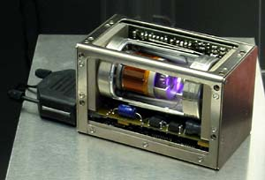
Other sources of error in GNSS positions
Each GPS satellite has 4 atomic clocks, to be sure that one is always working. Each costs ~$100,000 and is accurate to within 1 billionth of a second (1 nanosecond).
(3 x 10⁸) x 10⁻⁹ = 0.3 meters = 30 cm off!
http://www.kowoma.de/en/gps/satellites.htm
Notes:
GPS depends on extremely accurate time-keeping, so the very best clocks must be used.

Slide 20
Averaging in time reduces errors
Works the same…
Your location is:
37º 23.323’ N
122º 02.162’ W
The time is:
11:34.9722 (UTC)
ERRORS (after 8 hrs)
Horiz: +/- 2-4 mm (~1/8 in)
Vert: +/- 10-15 mm (~1/2 in)
ERRORS
Horiz: +/- 10 m (30 ft)
Vert: +/- 15 m (45 ft)
Notes:
Since each satellite maintains time very accurately (~1 nanosecond = 30 cm), it can tag its signal with the time of transmission. This information, together with the location of the satellite, also transmitted to the receiver, is sufficient to allow the receiver to calculate the range to each satellite, provided that the receiver also knows the time. Equipping receivers with atomic clocks would be very expensive, so the receiver tags the signal with the time of its internal clock to create a “pseudorange” (range plus an unknown clock correction). The software in the receiver then uses the pseudoranges from four satellites to solve for the four unknowns: three coordinates and the receiver clock correction.
Images: Vince Cronin (Baylor University)
High precision rates taken from GAMIT/GLOBK 10.6 release notes - http://geoweb.mit.edu/gg/
After 24 hours
Horz: +/- 1-2 mm
Vert: +/- 5 mm

Slide 21
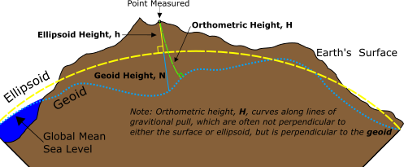
Typical GPS coordinates
Most GNSS data is recorded and reported using:
Geographic Coordinates
World Geodetic System 1984 (WGS 84)
A reference surface or datum composed of an ellipsoid
A geoid model (gravitational equipotential surface, EGM96)
Remember, elevations can be reported as ellipsoidal heights or orthometric heights
(Figure: Ian Lauer)

Slide 22
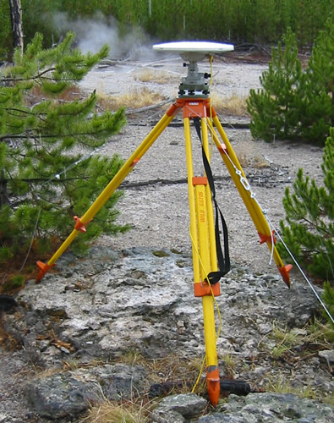
Precision depends on system
Static, Geodetic Campaign Systems
Occupation Time or Effort Required
Kinematic Systems
Easy Hard
Recreational& Mapping Systems
Survey Grade
0.5-5 m 0.01–0.03 m 0.005m
Dual-frequency receiver (ionosphere correction)
Precision of Position
(Images: Ben Crosby)
Notes:
More information at http://kb.unavco.org/kb/article/gps-data-collection-methods-70.html

Slide 23
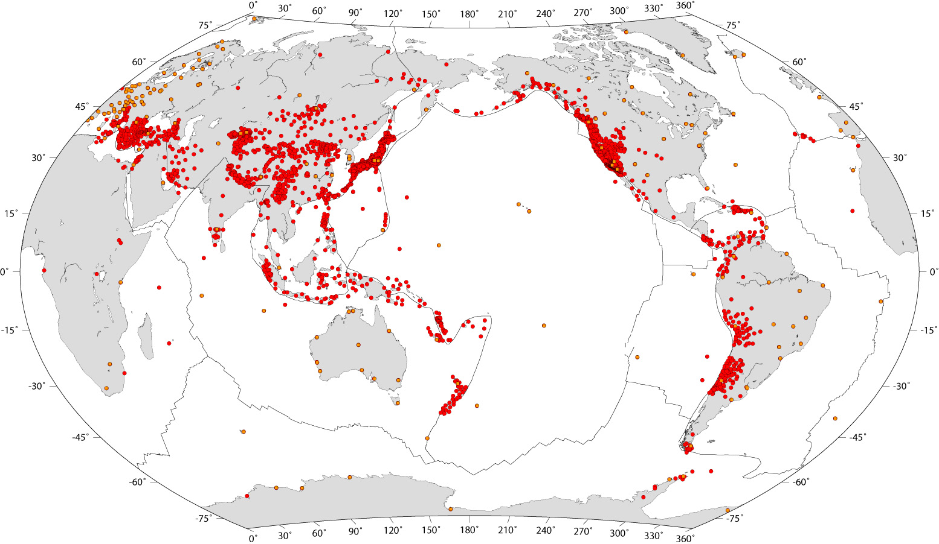
GNSS/GPS stations globally
> 10,000 stations with more added all the time
Some data freely available, some not
Notes:
GNSS refers to the entire global network using this basic type of technology (global navigation satellite system)
Technically, GPS, is the USA system and only refers to the satellites within our country purview, but GNSS is not yet as well recognized a term as GPS.
Image from http://gsrm.unavco.org/data/images/1.2/sites.jpg

Slide 24
Societal value of GNSS-enabled research
Most people use it for location and navigation
But … GNSS-enabled science also provides:
Hazard early warning systems, saving lives
Landslide activity
Volcano inflation
Fault movement
Precise measurements of objects
Water resources (aquifers, snow pack, etc.)
Tracking of objects (organisms, rocks, currents)
Without GNSS, we could not know where things are without directly measuring them.

Slide 25
Static GNSS

Slide 26
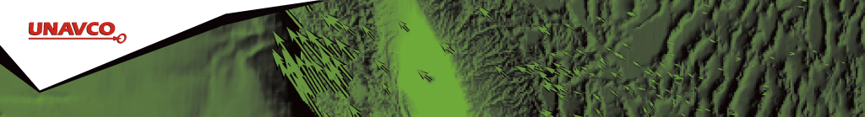
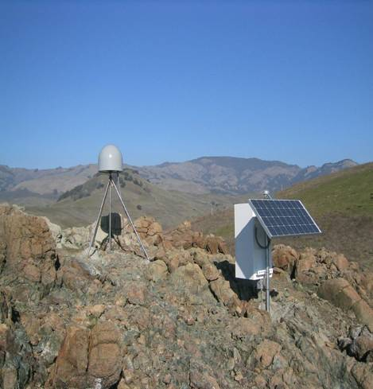
Anatomy of a high-precision permanent GNSS station
High-precision GNSS:
Development of global reference frames
Plate tectonic motions
Studies of large earth movements caused by
earthquakes
volcanoes
large-scale groundwater subsidence
etc
Notes:
Example of a typical remote GPS station. In urban areas, some are also fixed to the roof of large reinforced buildings and hooked into grid power supply with battery backup. Many stations are now being equipped with “real-time” communication to allow immediate transfer of data to researchers. In other places logistics or country-specific regulations require that data not be transmitted but is instead downloaded manually on a given schedule (monthly, quarterly, or annually, depending on the site)

Slide 27
Anatomy of a high-precision permanent GNSS station
GNSS antenna inside of dome
Monument solidly attached into the ground with braces.
If the ground moves, the station moves.
Solar panel for power
Equipment enclosure
GNSS receiver
Power/batteries
Communications/ radio/ modem
Data storage/ memory
Notes:
Example of a typical remote GPS station. In urban areas, some are also fixed to the roof of large reinforced buildings and hooked into grid power supply with battery backup. Many stations are now being equipped with “real-time” communication to allow immediate transfer of data to researchers. In other places logistics or country-specific regulations require that data not be transmitted but is instead downloaded manually on a given schedule (monthly, quarterly, or annually, depending on the site)

Slide 28
High-precision GNSS requires…
Stable monuments
Multiple stations
Sophisticated processing
Collecting lots of data
Using the carrier phase
Dual-frequency receivers
High-precision orbital information (ephemeris)
→ with several years of data can determine velocities to 1–2 mm/yr
Notes:
The primary GPS signal is transmitted at a “carrier’ frequency of 1575 MHz (“L-band”), corresponding to a wavelength of 19 cm. As with FM radio, This signal is then modulated at a much lower frequency to each modulated to incorporate information about the time and location of the satellites. The precision of the pseudorange is limited by the modulation frequency to about 10 cm. In high-precision GPS we use the carrier phase itself to obtain a measurement precision of 10 cm
Simple GPS receivers use code-phase to determine locations to an accuracy of 3–6 meters. Essentially code-phase is bigger chunks of signal. High-precision receivers use the carrier phase of the signal. You can think of this as being able to line up smaller chucks of code between the satellite and the receiver. This leads to smaller errors and more precise locations. Trimble has a more full explanation of the difference (http://www.trimble.com/gps_tutorial/sub_phases.aspx).
Dual-frequency receivers can “tune in” to the satellite signal at more than one frequency. You can think of this as listening to more than one radio station at the same time. In the case of GPS, this can allow for reduction in error from the ionosphere delays.

Slide 29
Static GNSS techniques
Long-duration occupations over well-monumented marks
Permanent stations are fixed using deep anchors and run continuously
Campaign stations are revisited infrequently (~1/year) and occupied for 8 to 48 hours
Data is always differentially corrected in post-processing using data from other nearby GNSS stations
LowIntermediate Precision: OPUS, CSRS
High Precision: GAMIT, GLOBK, TRACK, GIPSY-X → Precise point positioning (PPP)
Highest quality antennas and receivers

Slide 30
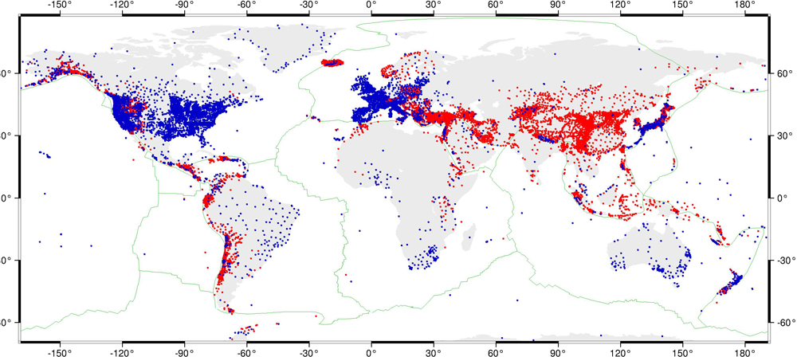
Static GNSS stations
> 20,000 static stations with more added all the time
Some data freely available, some not
GNSS = Global Navigation Satellite System
https://www.unavco.org/science/snapshots/solid-earth/2015/kreemer.html
Notes:
GNSS refers to the entire global network using this basic type of technology (global navigation satellite system)
Technically, GPS, is the USA system and only refers to the satellites within our country purview, but GNSS is not yet as well recognized a term as GPS.

Slide 31
What is possible with static GNSS products?
Spatial positions within a few millimeters.
Requires intensive, high-precision processing → PPP, special software
Thus . . . can track very small changes
Plate motions, earthquakes
Deformation due to hydrology
Snow or reservoir loading
Groundwater withdraw
Deformation due to volcanic activity
Pre-eruption doming
Caldera collapse
Landslides / slope failures
Sinkholes

Slide 32
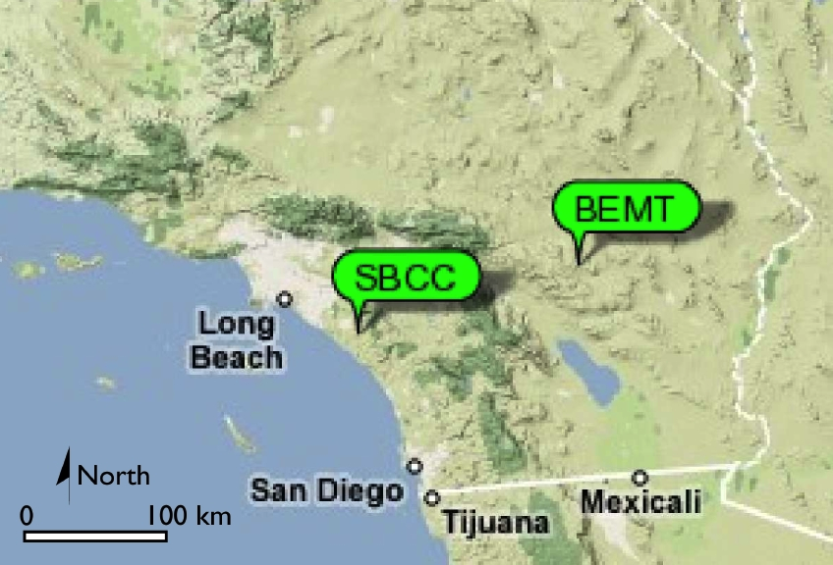
Where is that chunk of crust going?
Example: using GPS velocities to understand plate motions
Two PBO stations in California
Twenty-nine Palms,(BEMT)
Mission Viejo (SBCC)
Notes:
Southern California has numerous PBO stations, but let’s look at just two stations to see what we can learn from different velocities.
Background image from Google Maps.
Labels from UNAVCO http://www.unavco.org/education/resources/data-for-educators/data-for-educators.html

Slide 33
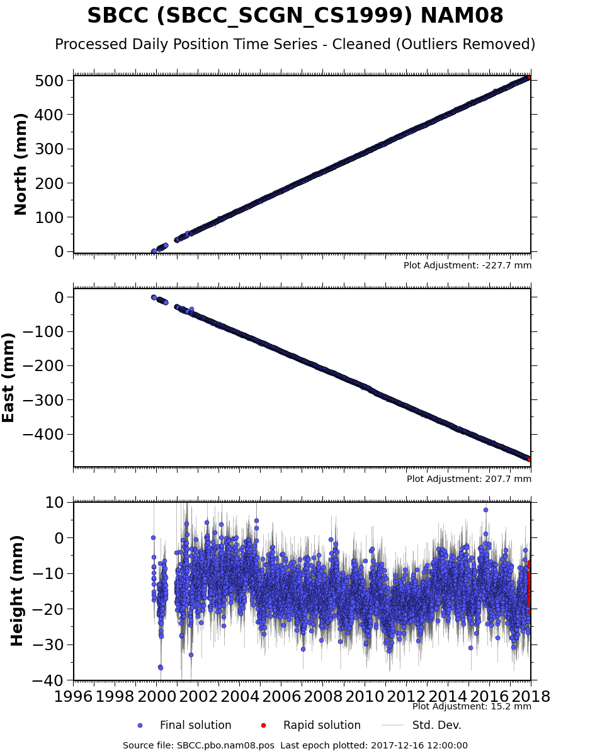
GPS time-series data
Station position over time
North–South
East–West
Up–Down
http://www.unavco.org/instrumentation/networks/status/pbo/overview/SBCC
Notes:
A variety of data products are available for each PBO station (http://www.unavco.org/instrumentation/networks/status/pbo/gps), but the most basic processed data is the station position over time = “time series.” The position is broken into the three orthogonal directions and set to an arbitrary zero datum. The most common reference frame for PBO data is North American 2008 (NAM08) reference grame, which assumes that the eastern North America is not moving and all the motion in western North America is shown relative to this fixed stable east. For more on reference frames: https://www.unavco.org/software/visualization/GPS-Velocity-Viewer/GPS-Velocity-Viewer-frames.html
Vertical data are always much less accurate because of the angle to the satellite (if we could only put satellites below the surface of the Earth, vertical accuracy would improve).

Slide 34
GPS time-series data
From the changing position, velocity can be calculated using slope (rise-over-run)
26.8 mm/yr
510 mm
north
19 years
25.0 mm/yr
475 mm
west
~8 mm down
~0.4 mm/yr
http://www.unavco.org/instrumentation/networks/status/pbo/overview/SBCC

Slide 35
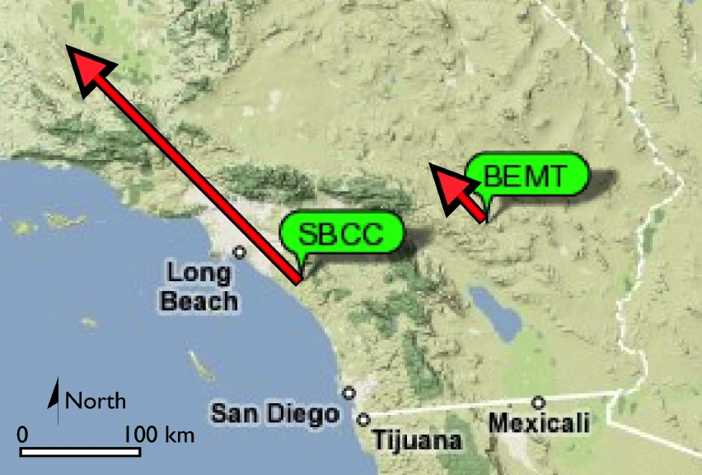
Two different velocities
Why the difference?
20 mm/yr
Same process yields much slower velocity at BEMT
Notes:
Ask your students to think about WHY there might be this great different in velocity between two nearby stations?

Slide 36
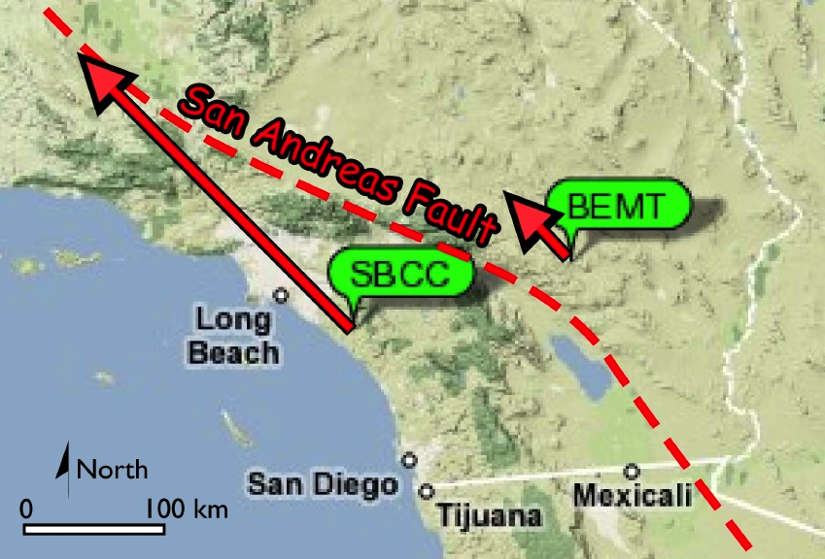
San Andreas Fault!
20 mm/yr
Notes:
The San Andreas Fault lies between these two stations so of course SBCC is moving much more quickly than BEMT

Slide 37
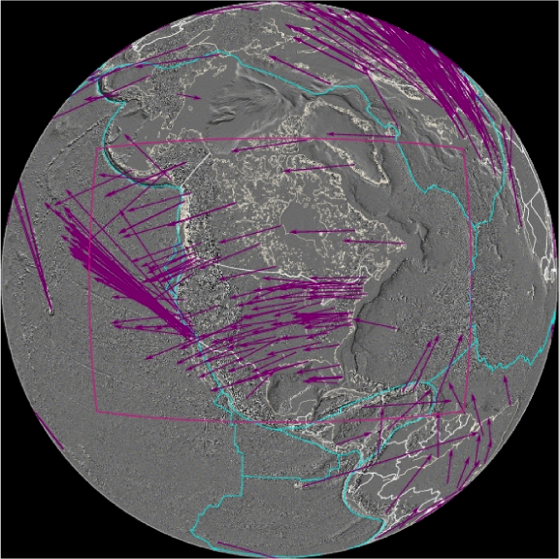
Reference Frames
All velocities are RELATIVE to a given reference frame
Velocities compared to International Terrestrial Reference Frame 2008 (IGS08 is GPS reference frame name)
Hot spot constellation as “stable”
Notes:
Compared to plate motions, hot spots are much more fixed, so a global reference frame has been defined in comparison to that hot spot constellation.
Image from UNAVCO

Slide 38
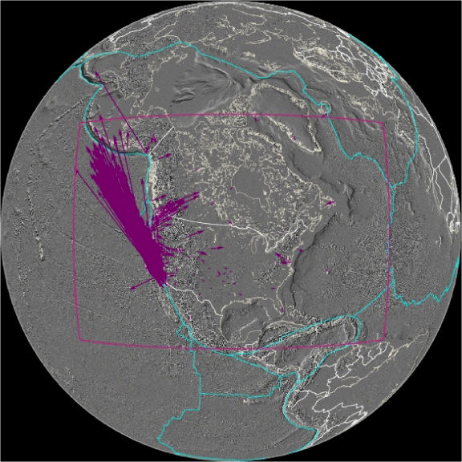
Reference frames
All velocities are RELATIVE to a given reference frame
Velocities compared to stable North America (called NAM08 reference frame)
Eastern North America as “stable”
Notes:
More useful for most typical applications is to consider a local reference frame, where movement in a deforming plate boundary is compared to the more stable, less-deforming region.
Image from UNAVCO
For more on reference frames see:
https://www.unavco.org/software/visualization/GPS-Velocity-Viewer/GPS-Velocity-Viewer-frames.html

Slide 39
Societal benefits
Static GNSS data are used in a wide variety of surface deformation applications.
Some are directly supporting human needs
Tracking hazardous features such as landslides, faults, or volcanos
Tracking changes in water resources
Some are indirectly providing insight into the way the earth works
Plate motions
Discovering new faults
Some static, continuous sites are used for corrections to other GNSS data, aiding industry.

Slide 40
Real-time kinematic GNSS

Slide 41
Motivations
Question:
We want precise positions without having to spend hours and hours surveying
What could we do?

Slide 42
Motivations
Question:
We want precise positions without having to spend hours and hours surveying
What could we do?
Important 2nd question:
What are the sources of error in a GNSS signal?

Slide 43
Motivations
Question:
We want precise positions without having to spend hours and hours surveying
What could we do?
Important 2nd question:
What are the sources of error in a GNSS signal?
Satellite clock errors
Ephemeris errors --> errors in the satellites’ locations
Troposphere / ionosphere delays
Dilution of Precision → affect of satellite geometry
Multipath error
Receiver quality

Slide 44
Motivations
Question:
We want precise positions without having to spend hours and hours surveying
What could we do?
Important 2nd question:
What are the sources of error in a GNSS signal?
Satellite clock errors
Ephemeris errors --> errors in the satellites’ locations
Troposphere / ionosphere delays
Dilution of Precision → affect of satellite geometry
Multipath error
Receiver quality
Very similar for nearby stations

Slide 45
Motivations
Question:
We want precise positions without having to spend hours and hours surveying
What could we do?
Answer:
Real-time kinematic!
Use two GNSS receivers
One has a “known” location and transmits the difference or “error” from that position to its estimated
The correction is then broadcast via local radio to the second receiver

Slide 46
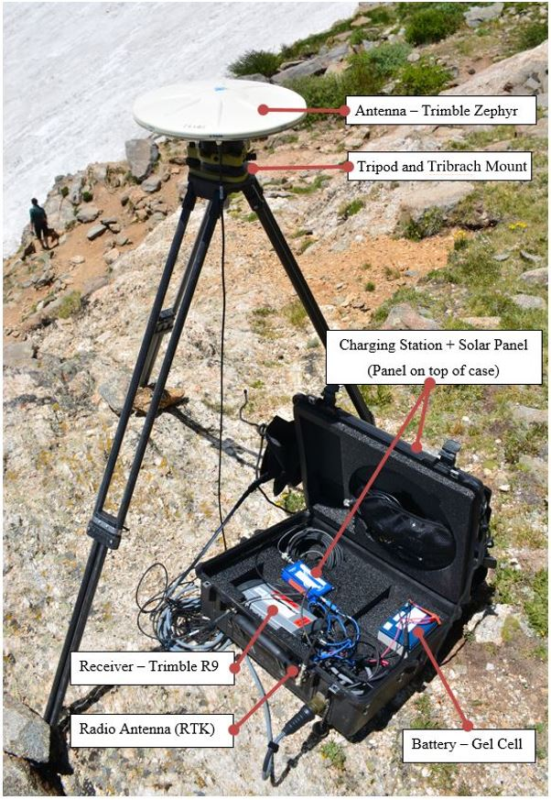
Kinematic components
GNSS Antenna
Radio
Antenna
GNSS
Receiver
Base Station and Radio
Rover Antennas and Receiver
(Images: Ian Lauer, Ben Crosby)

Slide 47
Kinematic systems
Base station antenna receives data from satellites.
The position drifts over time relative to the known, stable location of the antenna. This offset is communicated to the rover as a correction.
At the same time, rover antenna also receives position data from satellites.
Rover also receives a position correction from the base, in real time for RTK.
Base
Rover
(Images: Ben Crosby)

Slide 48
Kinematic survey design
Base Station
Located in a stable, safe, unobstructed place
Line of sight for radio communication to rover
< 10 km from rover location
Ideally set up over known monument
Rover
Close to and in line of site with base for corrections
Occupy points for 5–120 sec, keep pole vertical
Name and describe each point in field book
Avoid cover and multi-path, confirm corrections

Slide 49
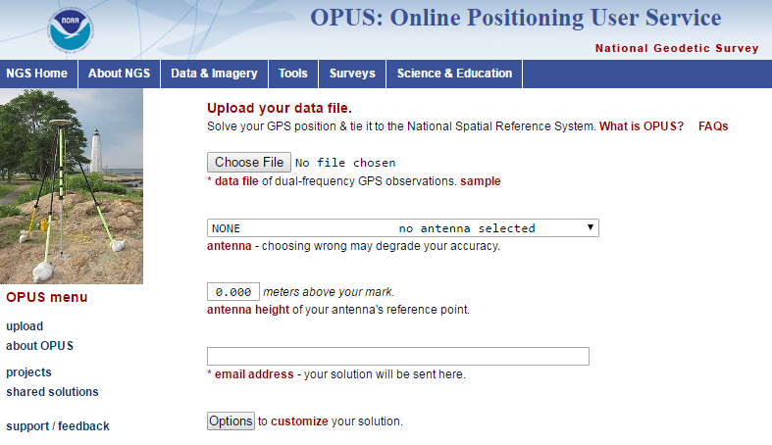
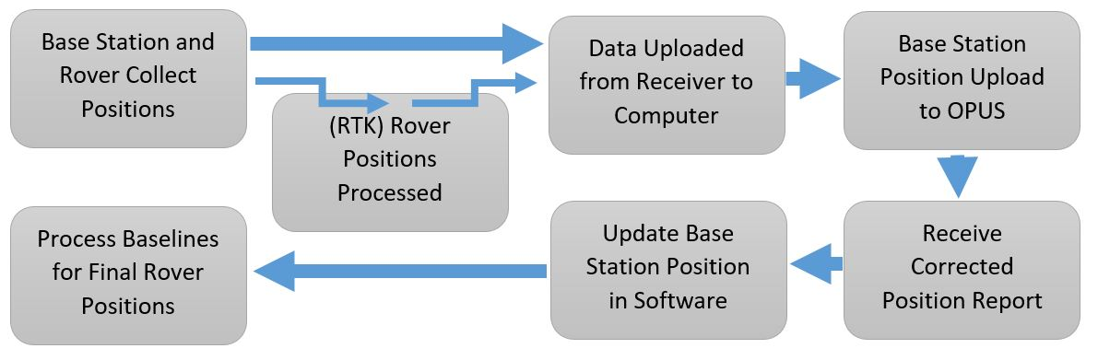
”Post-process Kinematic” workflow
If base is not over a known point, you must post-process to get an accurate position

Slide 50
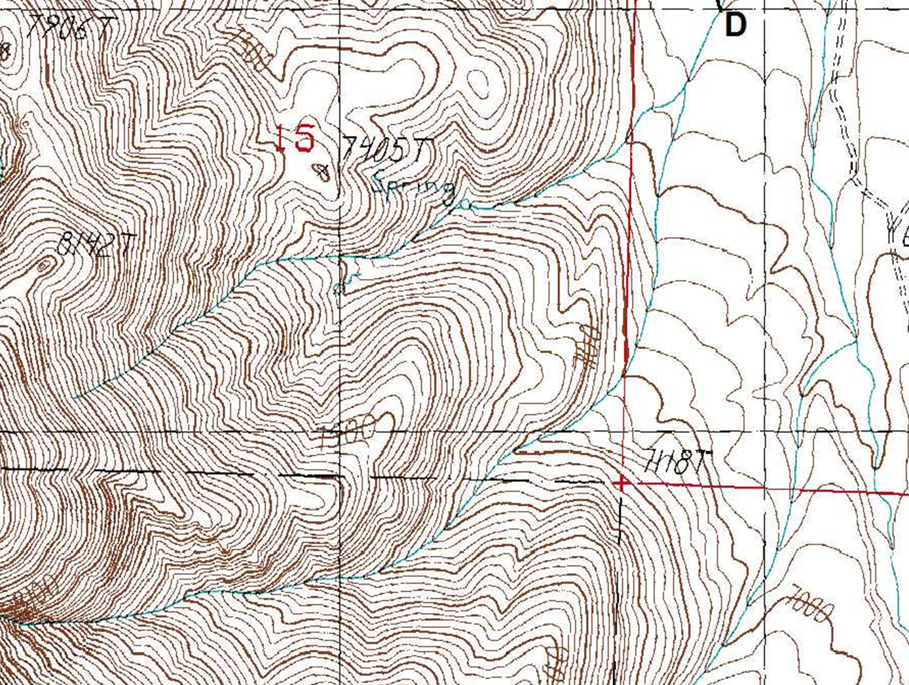
PPK – Post-processed kinematic
Base Station
Three Different Rover Positions
assumed ‘here’
raw base obs.
raw rover obs.
rover RTK adj.
t₁
corrected base
t₂
t₁
corrected rover
t₃
t₂
t₃

Slide 51
Kinematic post-processing
Post processing is only necessary if the base was set up over an unknown point
Download data from base to PC software for your hardware.
Export base dataset as a RINEX formatted file
Upload RINEX to OPUS website, specifying all necessary information regarding base antenna type and height (best to wait 4+ hours after collection before uploading)
Update your base position with the new, OPUS-corrected position in your PC software
Propagate the change in base to all your rover positions

Slide 52
Conclusions
GNSS – a powerful tool for many applications
Based on measuring distances to 4+ satellites of known position in 3D space
Main difference between a phone GNSS and a survey-grade GNSS is the dual-frequency ionosphere correction (~3 m to 30 cm error)
Additional processing can reduce error to less than a mm/yr
GNSS velocities track plate motions

